Slide 1
3PHY1INF
SOP Project
Vincent Glauser, Sylvain Lott, Tristan Henchoz, Katja S. Moos

Slide 2
Intro Astrophysics
Light pollution
Units: 1 Lux ≈ 1 candle at distance 1 m
Direct sunlight: 32’000-100’000 lx
Living room: 50 lx
Full moon, clear night: 0.05-0.3 lx
Moonless, night sky: 0.0001 lx

Slide 3
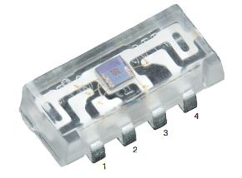
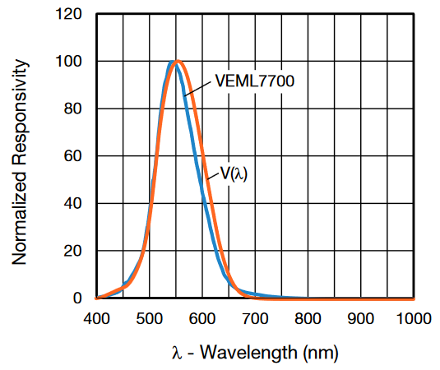
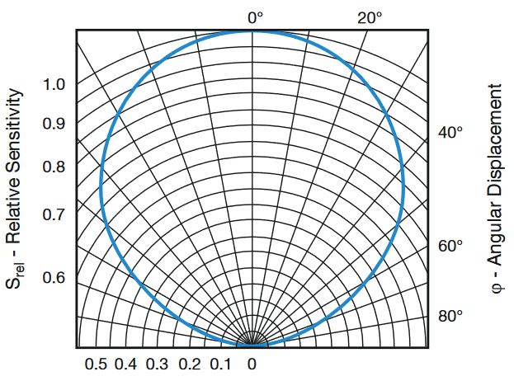
Sensor

Slide 4
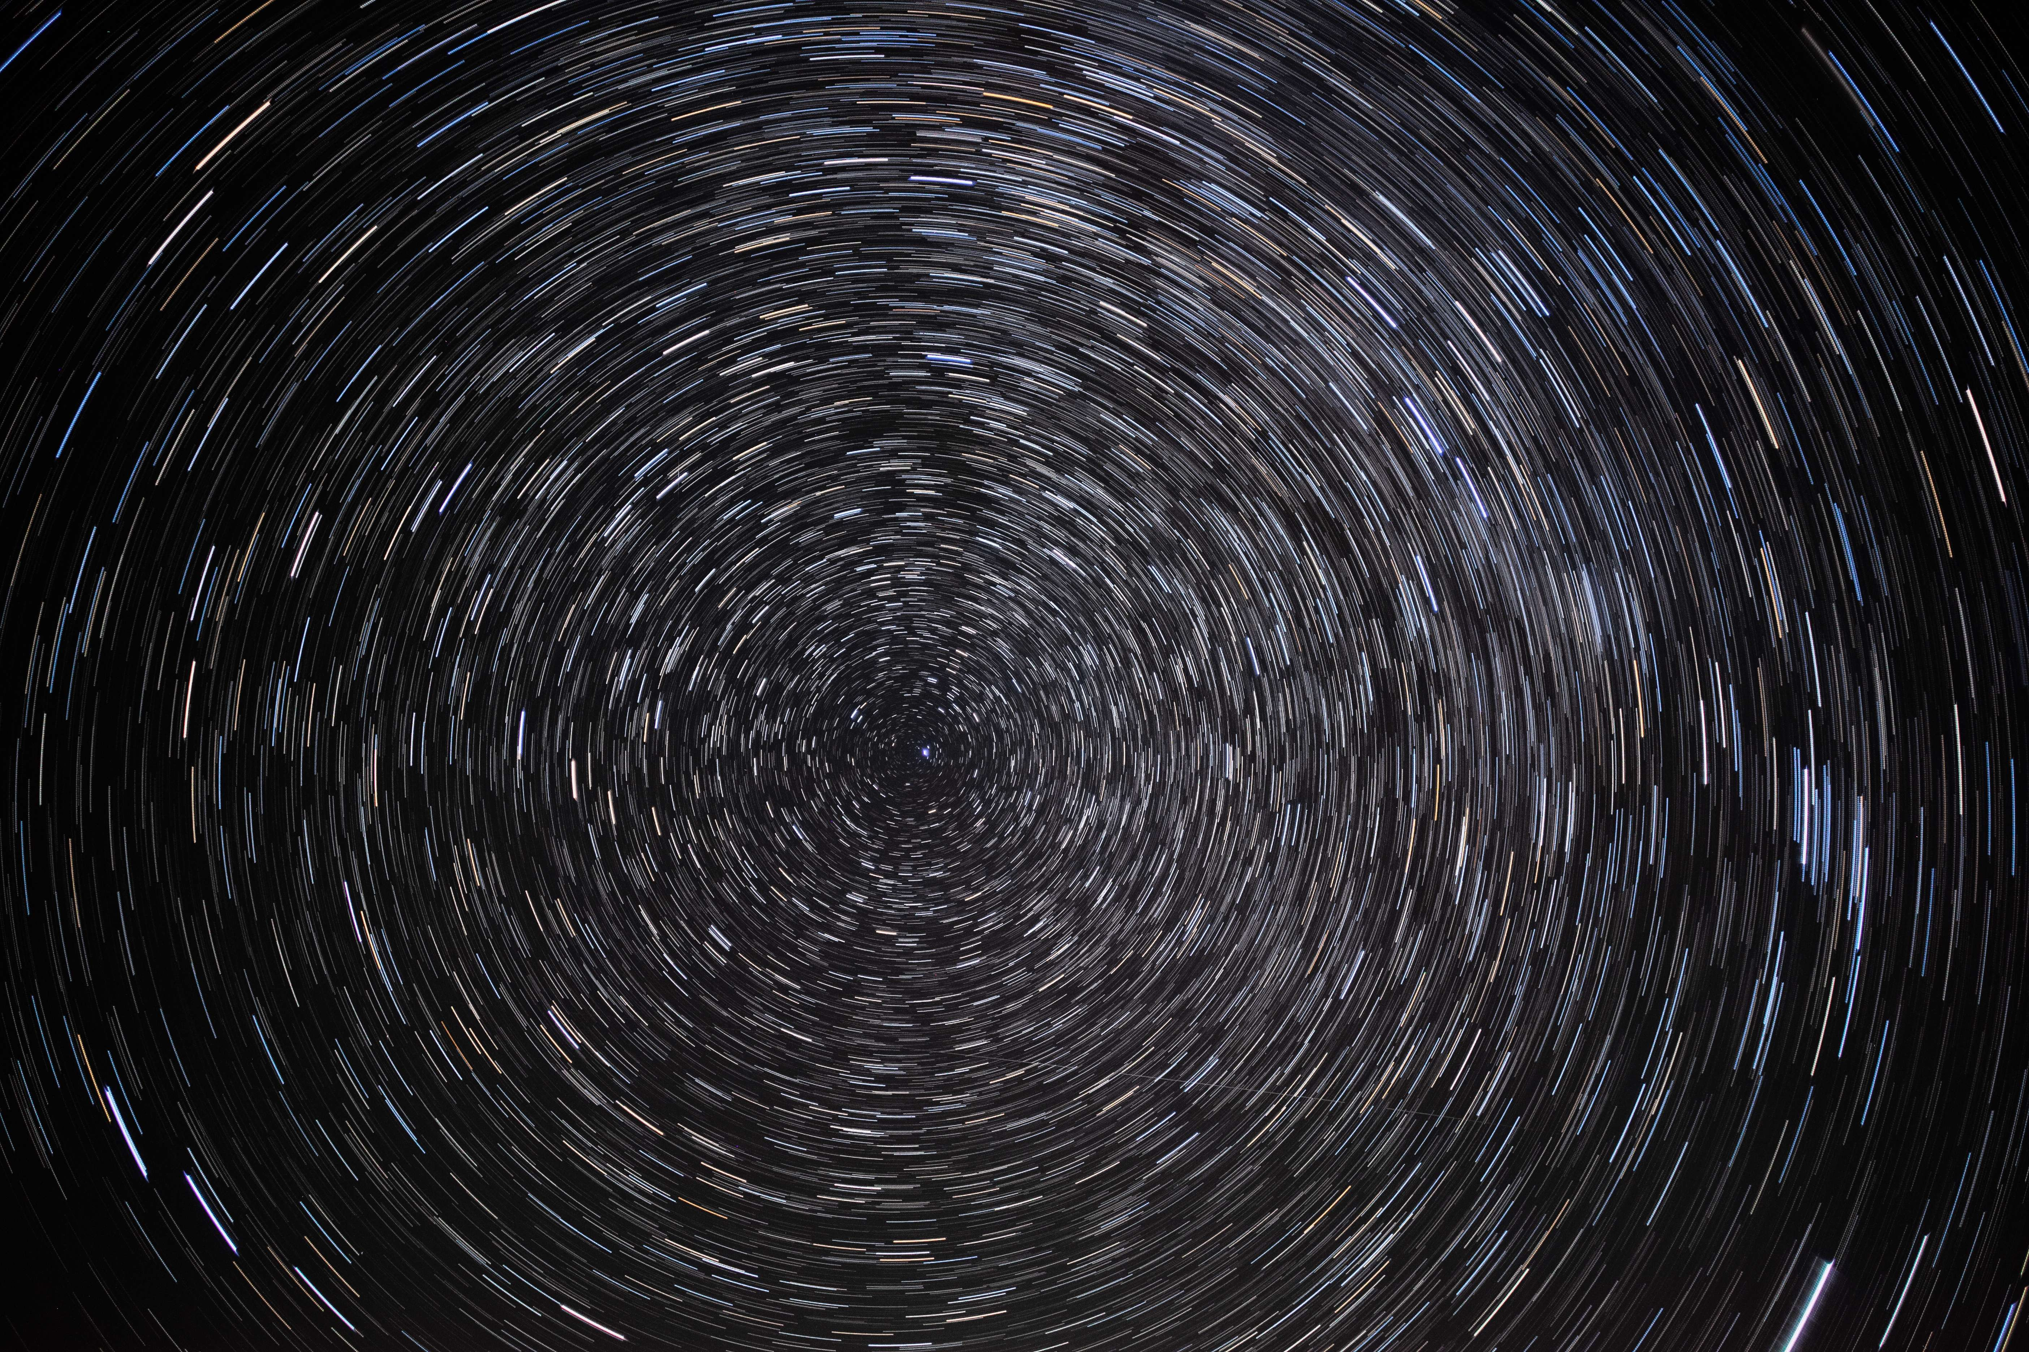
Gain & Integration time
Sensibility of the light:
Gain (ISO): 2 (max.)
Time to capture the light
Integration time: 800 ms (max.)
The higher the two, the better.

Slide 5
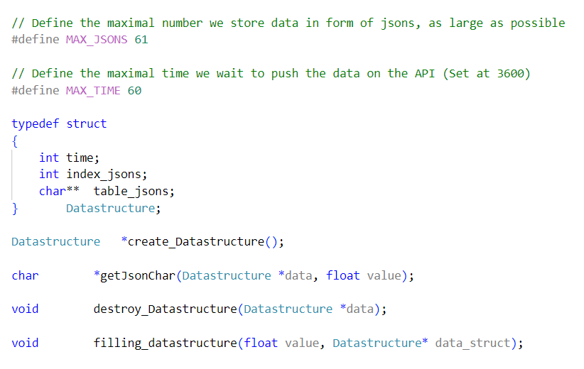
DatastructurE
Array with index
Quickly implemented
Direct access to all elements
Overwrite elements from top to bottom

Slide 6
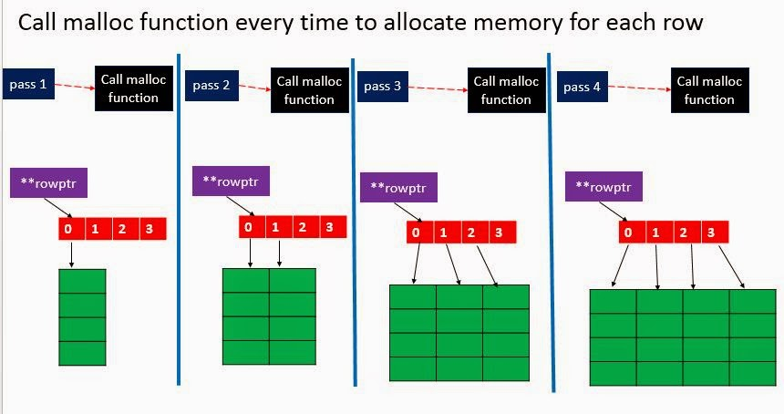
Memory

Slide 7
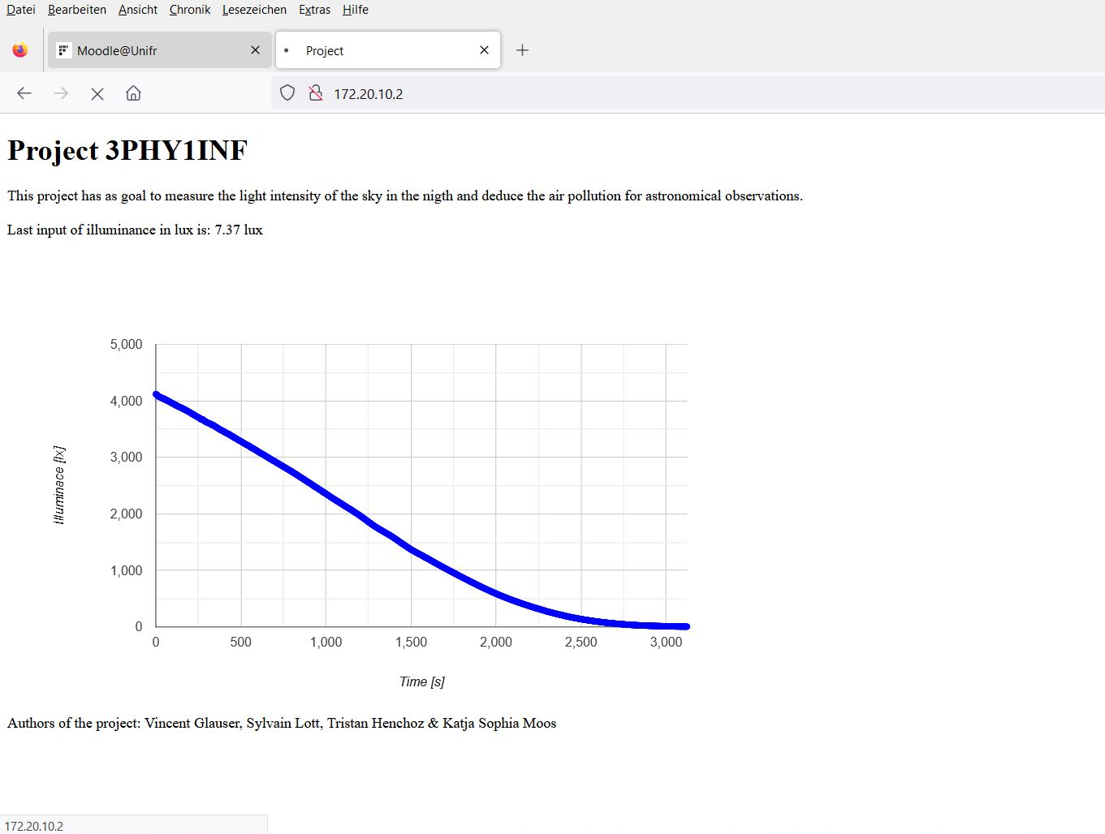
API

Slide 8
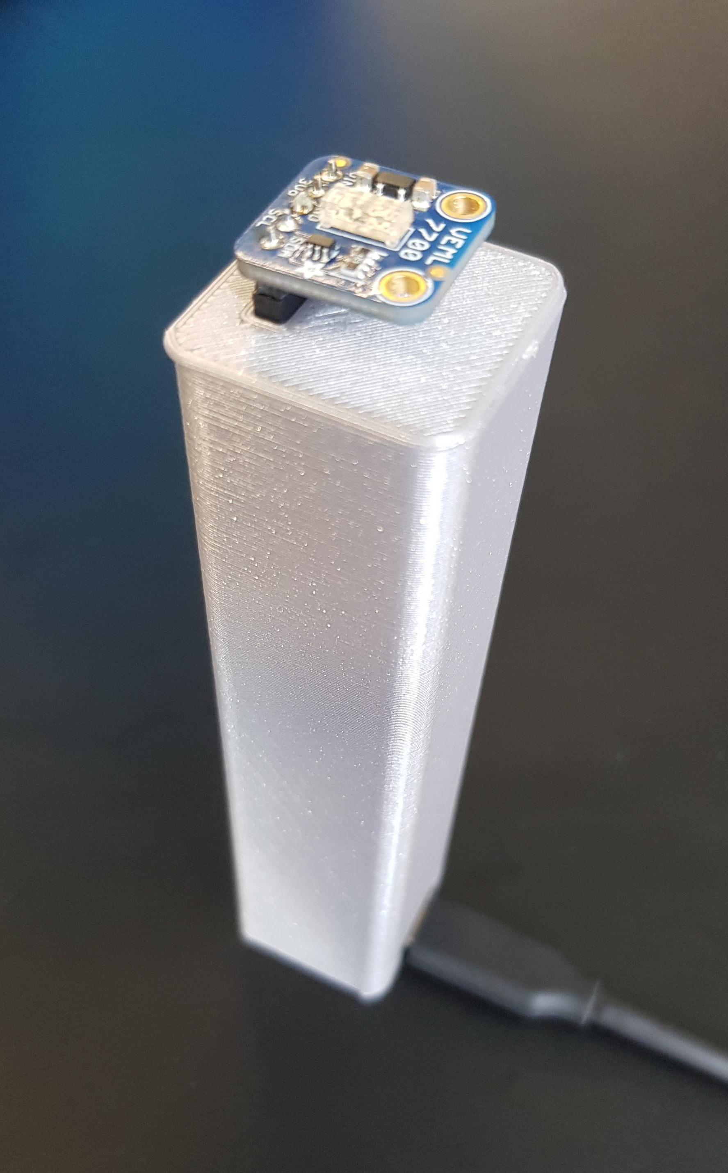
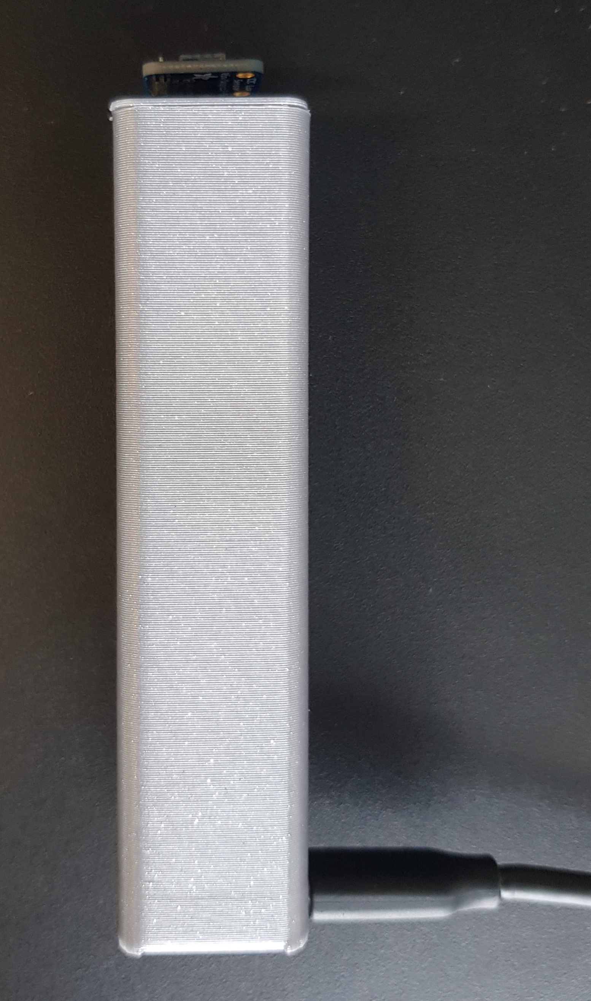
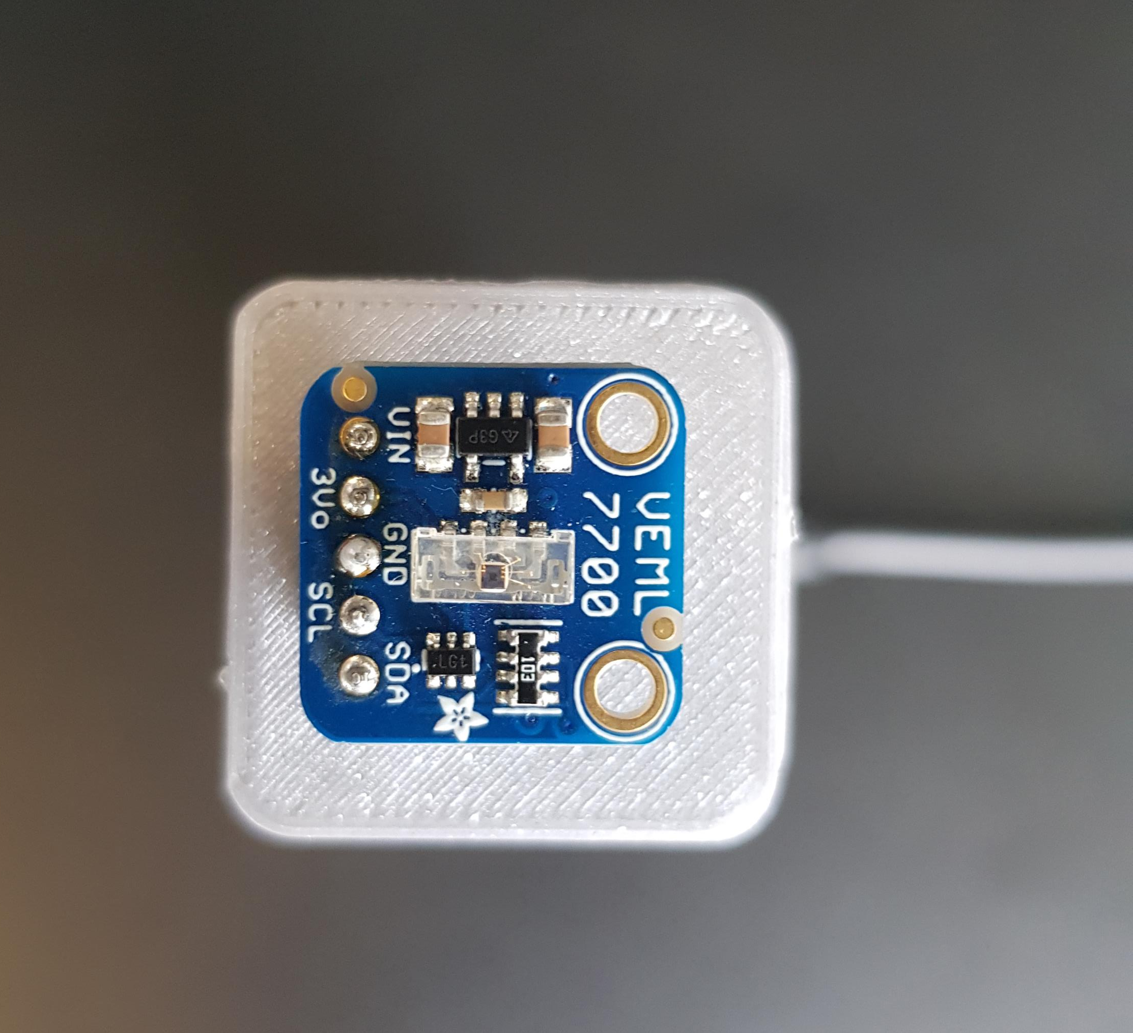
Box
Focus for light pollution comming from sky
Stability
Hide the technical components

Slide 9
Live presentation

Slide 10
Limitations
High lux => precise
< 0.1 lux => unprecise

Slide 11
Conclusion
Measure number of lx
Store in array
Connect to API
Send array elements
Line plot in HTML

Slide 12
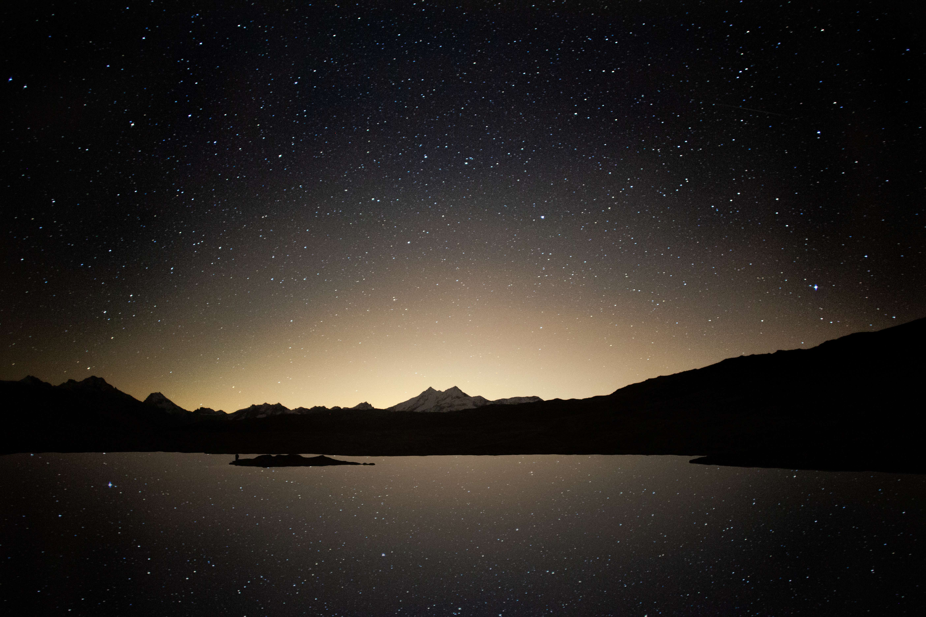
Questions?

Slide 13
Sources
Pictures:
https://www.vishay.com/en/product/84286/
https://commons.wikimedia.org/wiki/File:Summit-lake-wv-night-sky-reflection_-_West_Virginia_-_ForestWander.jpg
Text:
https://en.wikipedia.org/wiki/Lux

